Slide 1
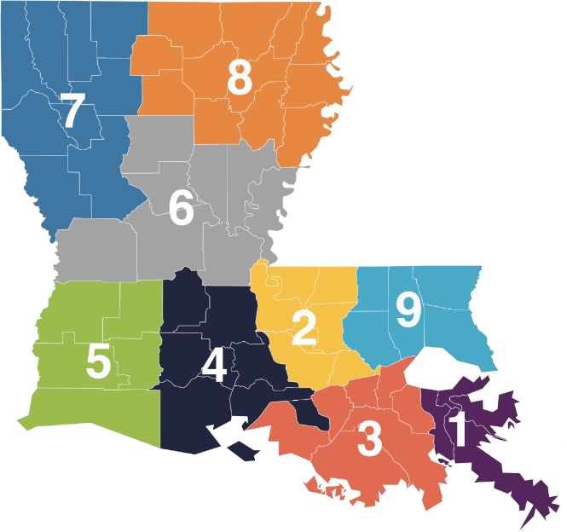
Regional Service Centers
Louisiana Commission for the Deaf
Use the information below to contact your local Region Service Center (RSC). They manage the distribution of equipment and services for the Louisiana Commission for the Deaf. The regional map on the left can be used to help identify which center is closest to you. Give them a call to set up an appointment.
Are you a provider or organization in need of an ASL interpreter? Regional Service Center staff can help you schedule an interpreter for your D/deaf patients.
New Orleans Area: Regions 1 & 3
Lighthouse Louisiana
123 State Street, New Orleans, LA 70118
(504) 899-4501 ext. 255 | Toll-Free (888) 792-0163 |
VP (504) 229-0945 | lighthouselouisiana.org
Alexandria Area: Region 6
New Horizons Independent Living Center
3717 Government Street, Suite 7, Alexandria, LA 71302
(318) 484-3596 | Toll-Free (888) 361-3596
nhilc.org
Baton Rouge/Covington Area: Regions 2 & 9
Lighthouse Louisiana
One American Place, 301 N Main St, Ste 150 Baton Rouge, LA 70825 | (225) 529-2749
Toll-Free (888) 792-0163 | VP (225) 224-3147
lighthouselouisiana.org |
Shreveport Area: Region 7
New Horizons Independent Living Center
1701 North Market Street, Shreveport, LA 71107 (318) 671-8131 | Toll-Free (877) 219-7327 |
VP (318) 459-9233 | Interpreter Call or Text (318) 402-7313 nhilc.org
Lafayette Parish
Affiliated Blind of La. Training Center
409 W. St. Mary Boulevard, Lafayette, LA 70506 (337) 234-6492 | VP (337) 205-0500
affiliatedblind.org
Monroe Area: Region 8
New Horizons Independent Living Center
1401 Hudson Lane, Suite 200, Monroe, LA 71201
(318) 323-4374 | Toll-Free (800) 428-5505
nhilc.org
Acadiana Area: Region 4
Southwest Louisiana Independence Center
216 A La Rue France, Lafayette, LA 70508
(337) 269-0027 | slic-la.org
Lake Charles Area: Region 5
Southwest Louisiana Independence Center 4320 Lake Street, Lake Charles, LA 70605 (337) 477-7194 | Toll-Free (833) 600-5766 |
VP (337) 214-0223 | slic-la.org
If you have any questions about the Louisiana Commission for the Deaf, please contact us at
lcd@la.gov or 1-800-256-1523. Visit us online at ldh.la.gov/index.cfm/page/318.

Slide 2
Regional Service Centers by Parish
Louisiana Commission for the Deaf
Use the information below to contact your local Region Service Center (RSC). They manage the distribution of equipment and other services for the Louisiana Commission for the Deaf. The regional map on the left can be used to help identify which center is closest to you. Give them a call to set up an appointment.
Are you a provider or organization in need of an ASL interpreter? Regional Service Center staff can help you schedule an interpreter for your D/deaf consumers.
New Orleans Area: Regions 1 & 3
Lighthouse Louisiana
Jefferson, Orleans, Plaquemine, St Bernard Assumption, Lafourche, St. Charles, St. James, St. John the Baptist, St. Mary, Terrebonne Parishes lighthouselouisiana.org
Alexandria Area: Region 6
New Horizons Independent Living Center
Avoyelles, Catahoula, Concordia, Grant, LaSalle,
Rapides, Vernon, Winn Parishes nhilc.org
Baton Rouge Area: Region 2
Lighthouse Louisiana
Ascension, East Baton Rouge, East Feliciana, Iberville, Pointe Coupee, West Baton Rouge, West Feliciana Parishes
lighthouselouisiana.org
Shreveport Area: Region 7
New Horizons Independent Living Center
Bienville, Bossier, Caddo, Claiborne, Desoto, Natchitoches, Red River, Sabine, Webster Parishes nhilc.org
Lafayette Area: Region 4
Affiliated Blind of La. Training Center
Lafayette Parish affiliatedblind.org
Monroe Area: Region 8
New Horizons Independent Living Center
Caldwell, East Carroll, Franklin, Jackson, Lincoln, Madison, Morehouse, Ouachita, Richland, Tensas,
Union, West Carroll Parishes nhilc.org
Covington Area: Region 9
Lighthouse Louisiana
Livingston, St. Helena, St. Tammany, Tangipahoa, Washington Parishes lighthouselouisiana.org
Acadiana Area: Region 4
Southwest Louisiana Independence Center
Acadia, Evangeline, Iberia, St. Landry,
St. Martin, Vermillion Parishes slic-la.org
Lake Charles Area: Region 5
Southwest Louisiana Independence Center
Allen, Beauregard, Calcasieu, Cameron, Jefferson Davis Parishes
slic-la.org
If you have any questions about the Louisiana Commission for the Deaf, please contact us at
lcd@la.gov or 1-800-256-1523. Visit us online at ldh.la.gov/index.cfm/page/318.

Slide 3
Regional Service Centers Staff Information
Louisiana Commission for the Deaf
New Orleans Area: Regions 1 & 3 Baton Rouge Area: Region 2 Covington Area: Region 9 Lighthouse Louisiana
Lake Charles Area: Region 5
Southwest Louisiana Independence Center
Randy Dartez, Director
Rocky Fusilier, Assistant Director
Phillip Credeur, Int. Assistant Director
Mona Richard, HAP/TAP
rdartez@slic-la.org
rocky@slic-la.org
phillip@slic-la.org
mona@slic-la.org
Dee Budgewater, President
Liz Fussell, BR Services
Jenice Heck, COO
Brett Holland, TAP/HAP Katelyn Billiot, TAP/HAP/TERP
Stacy Robinson, Accounting
dbudgewater@lighthouselouisiana.org efussell@lighthouselouisiana.org
jheck@lighthouselouisiana.org bholland@lighthouselouisiana.org deafservices@lighthouselouisiana.org srobinson@lighthouselouisiana.org
Damien Thibodeaux, HAP/TAP damien@slic-la.org
Allison Galbreath, TERP/Invoicing allison@slic-la.org
Shannon Kennedy, Accounting shannon@slic-la.org
(337) 477-7194 | VP (337) 214-0223
Toll-Free (833) 600-5766
Alexandria Area: Region 6
New Horizons Independent Living Center
New Orleans Office (504) 899-4501 | VP (504) 229-0945
Baton Rouge Office (225) 529-2749 | VP (225) 224-3147
Toll-Free (888) 792-0163
Lafayette Area: Region 4
Affiliated Blind of La. Training Center
Patricia Yoruw, Interim Director Allen Fields, HAP
Ken Zangla, TAP
pyoruw@nhilc.org afields@nhilc.org kzangla@nhilc.org
LaToya Foster, TERP lfoster@nhilc.org
(318) 484-3596 |Toll-Free (888) 361-3596
Shreveport Area: Region 7
New Horizons Independent Living Center
Patricia Yoruw, Interim Director pyoruw@nhilc.org Mitch Iddins, Advocacy Director mitchiddins@nhilc.org LaToya Foster, TERP/TAP/HAP lfoster@nhilc.org (318) 671-8131 | Toll-Free (877) 219-7327
Lynn Blanchard, Director
Christine Scott, SSP services
Erica Wallace, SSP coordinator
Jacob Fakouri, HAP/TAP
Eileen Landry, Accounting
lynnb@affiliatedblind.org christines@affiliatedblind.org ericaw@affiliatedblind.org
jacobf@affiliatedblind.org
eileenl@affiliatedblind.org
(337) 234-6492 | VP (337) 446-4648
Acadiana Area: Region 4
Southwest Louisiana Independence Center
Randy Dartez, Director
Rocky Fusilier, Assistant Director
Phillip Credeur, Int. Assistant Director
Paige Kelly, HAP
Danielle Credeur, HAP/TAP
Kayla Castille, HAP
(337) 269-0027
rdartez@slic-la.org
rocky@slic-la.org
phillip@slic-la.org paige@slic.-la.org danielle@slic-la.org kaylac@slic-la.org
Monroe Area: Region 8
New Horizons Independent Living Center
pyoruw@nhilc.org
Patricia Yoruw, Interim Director
Nandidra Gray, TAP/HAP ngray@nhilc.org
LaToya Foster, TERP lfoster@nhilc.org
(318) 323-4374 | Toll-Free (800) 428-5505

